Slide 1

Self-Driving Car Game
Team Members:
Akshay Bharadva
Chandrakanth Yarlagadda
Priyanka Choudhary
Sairaj Udayshankar
Shavez Azmi

Slide 2
Table of Contents
Slide Number | Contents
1. | Objectives
2. | Basic Features
3. | Advanced Features
4. | Solution Overview
5. | Key Technologies & Components
6. | Salutations

Slide 3
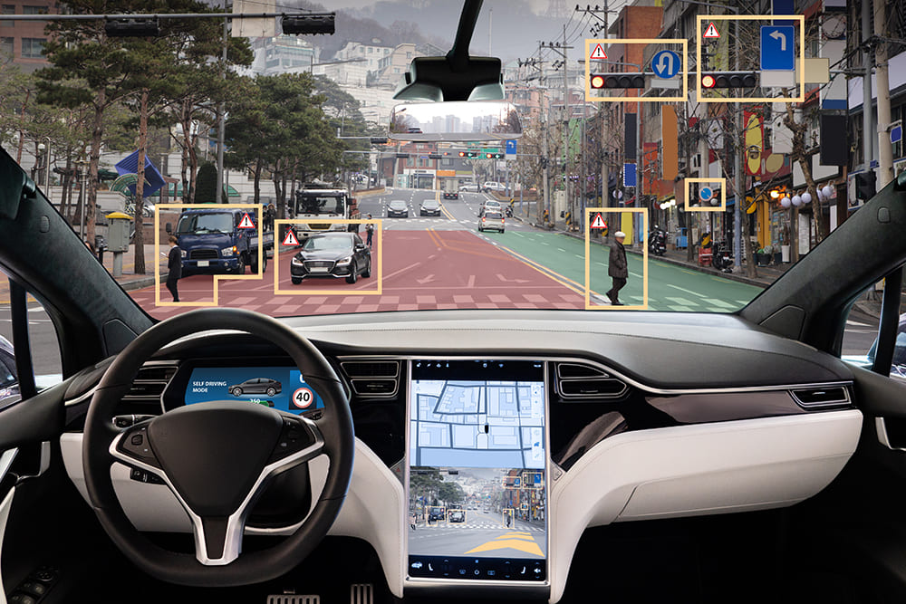
Objectives
Creating a self-driving car in a virtual environment using AI
Synthesizing real-life road obstacles like pedestrians
Performing real-time obstacle detection and automate avoidance
Abiding by traffic rules and following traffic lights
Detecting the shortest path to the destination

Slide 4
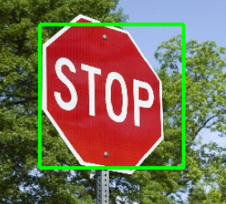
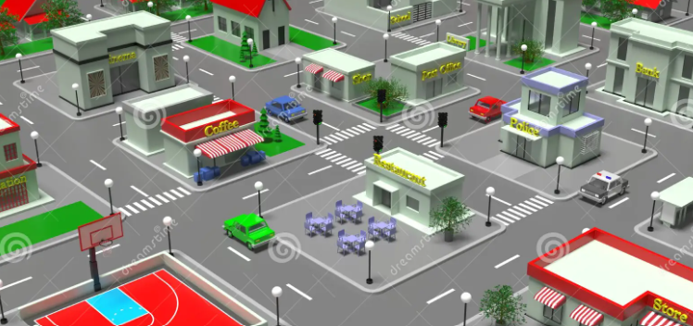
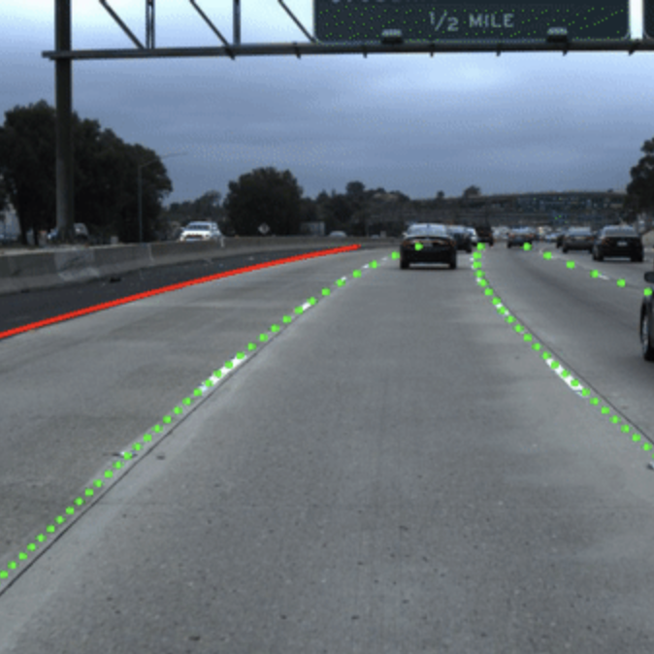
Basic Features
Different Maps
Vehicle Specifications
Steering, Acceleration and Braking
Training Mode and Auto-driving Mode
Road and Lane Detection
Taking Turns and Switching Lanes
Pedestrian and Obstacle Detection
Signal and Stop Sign Detection
Additional Features on Car Dashboard

Slide 5
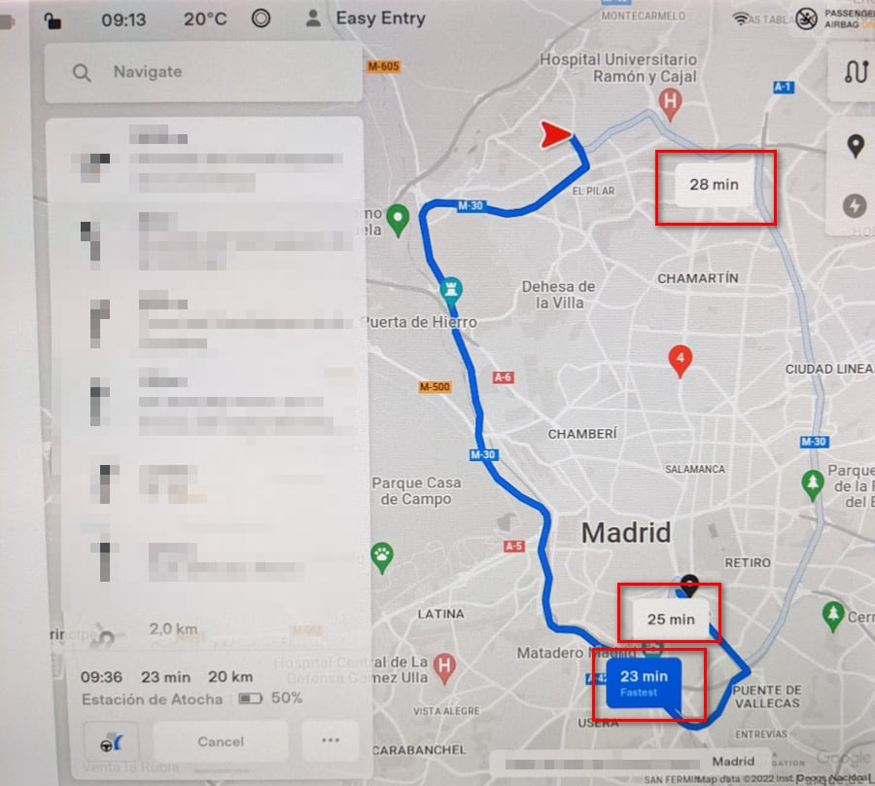
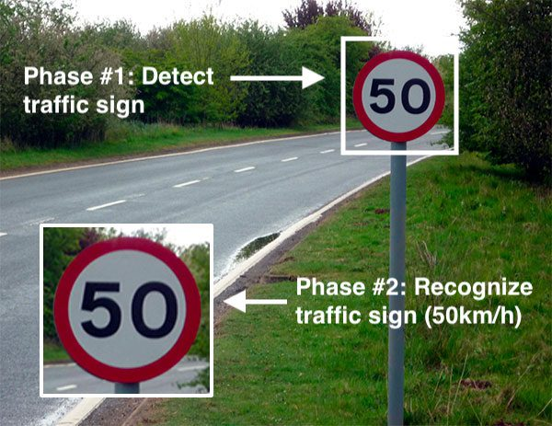
Advanced Features
Dynamic Routing
Air-bag Trigger in the Event of Collision
Changes due to Weather Conditions*
Response to Speed Signs & Sign Boards*
Shortest Route to Fuel Station*
Changes due to Low Tyre Air Pressure*
Skidding in Snow
* Will be developed in case there is remaining time after other features are developed.

Slide 6





Solution Overview

Slide 7
Key Technologies
Azure – Cloud Hosting
Open CV – Image Processing
Python –
Used with Open CV
Dynamic Routing
Bridge between Unity and Processing Systems
Unity – Game Engine
Hadoop Ecosystem –
Real-time Decision Making

Slide 8
THANK YOU

